Slide 1
Spectral Clustering (Unsupervised Learning)

Slide 2
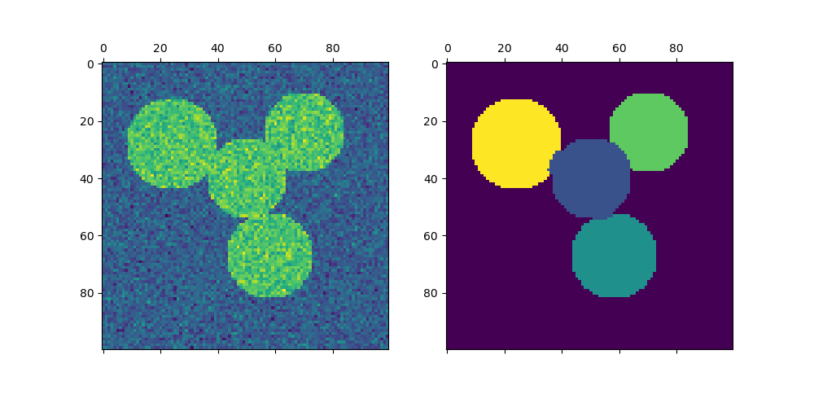
An image with connected circles is generated and spectral clustering is used to separate the circles.
SpectralClustering performs a low-dimension embedding of the affinity matrix between samples, followed by clustering,
e.g., by KMeans, of the components of the eigenvectors in the low dimensional space.
It is especially computationally efficient if the affinity matrix is sparse and the amg solver is used for the eigenvalue problem

Slide 3
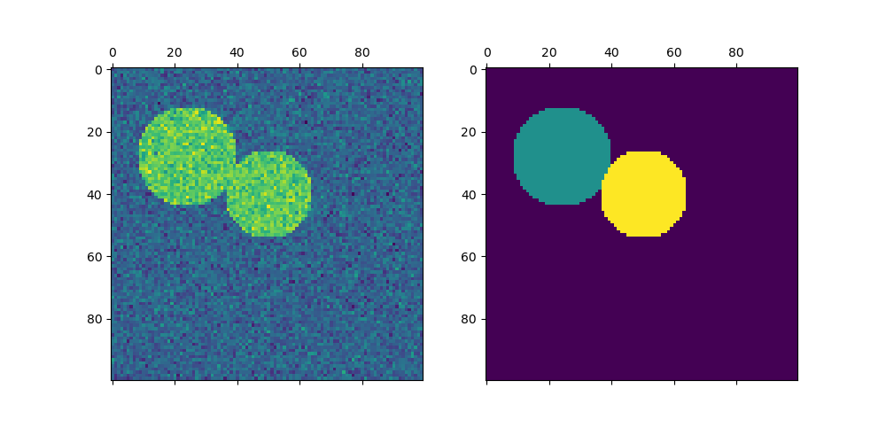
In summary, the code performs spectral clustering on a given graph, assigns cluster labels to the pixels within a specified region, and visualizes the original image alongside the segmentation results.
Adjust the parameters as needed for your specific image and clustering requirements.

Slide 4
In summary, the expression 1 + 0.2 * np.random.randn(*img.shape)
generates an array of random numbers that are centered around 1 with some variability controlled by the scaling factor (0.2).
This array is then added element-wise to the original image
img, introducing random noise to the image while maintaining a mean value of 1.
This kind of operation is commonly used to simulate noise in synthetic data for testing and experimentation.
Drawbacks:
Spectral clustering is a powerful technique, but like any method, it has its drawbacks.
Here are some common drawbacks of spectral clustering:
Sensitivity to Parameters:
Spectral clustering involves several parameters, such as the number of clusters the type of affinity matrix, and the
choice of eigenvectors.
The performance of spectral clustering can be sensitive to the choice of these parameters, and selecting optimal values
can be challenging.
Computational Complexity:
The computation of the eigenvectors and eigenvalues, especially for large datasets, can be computationally expensive.
This complexity makes spectral clustering less efficien for large-scale datasets compared to other clustering algorithms.
Memory Usage:
The affinity matrix used in spectral clustering can be memory-intensive, especiall for dense graphs.
Storing and manipulating the affinity matrix may become impractical for large datasets.

